Slide 1
Computer Programming
Decision Making

Slide 2
Decision Making
A conditional statement tells a program to execute an action depending on whether a condition is true or false. It is often represented as an if-then or if-then-else statement.
Very often when you write code, you want to perform different actions for different conditions. You can use conditional statements in your code to do this.
In PHP we have the following conditional statements:
if statement - executes some code if one condition is true
if...else statement - executes some code if a condition is true and another code if that condition is false
if...elseif...else statement - executes different codes for more than two conditions
switch statement - selects one of many blocks of code to be executed

Slide 3
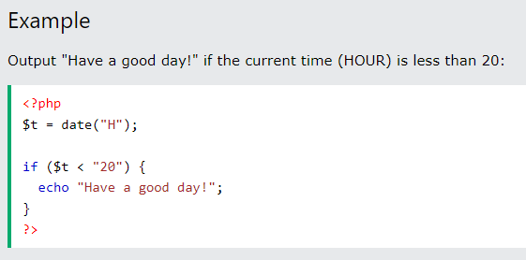
PHP - The if Statement
The if statement executes some code if one condition is true.

Slide 4
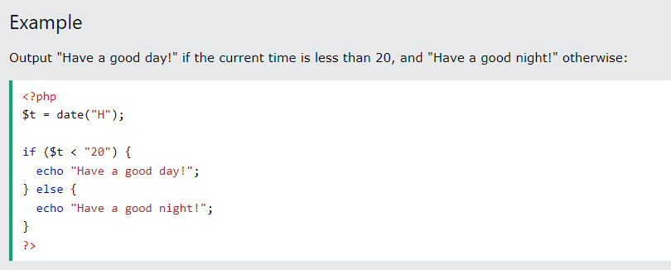
PHP - The if...else Statement
The if...else statement executes some code if a condition is true and another code if that condition is false.

Slide 5
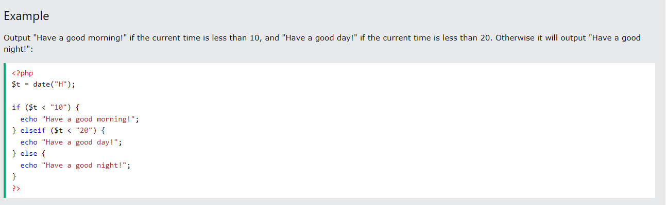
PHP - The if...elseif...else Statement
The if...elseif...else statement executes different codes for more than two conditions.

Slide 6
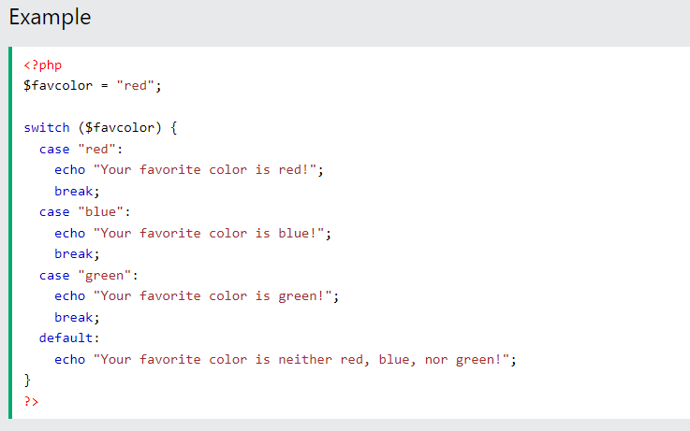
PHP - The switch Statement
The switch statement is used to perform different actions based on different conditions.

